Slide 1

Predicting the possibility of Heart Failures
using Supervised Learning Techniques

Slide 2

Why is it important to Predict Heart Failure?
It is the number 1 cause of Fatality in the world.

Slide 3






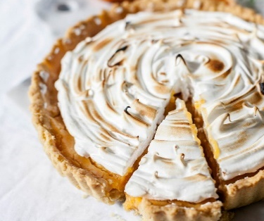

Tools and Workflow
Exploratory Data Analysis/
Feature Selection
Train/ Test data on models &
Cross Validate
Tune Parameters for Best Performance
Cross Validate and Display Findings

Slide 4
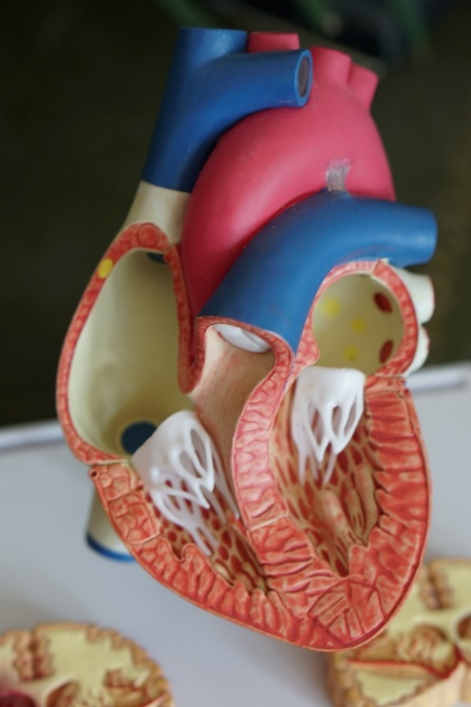
Data Details:
Discrete Data | Continuous Data
Gender | Age
Diabetes | Creatinine Phosphokinase (CPK):
Anemia | Ejection Fraction (EF)
High blood pressure | Platelets
Smoking | Serum Creatinine
Death | Serum Sodium

Slide 5
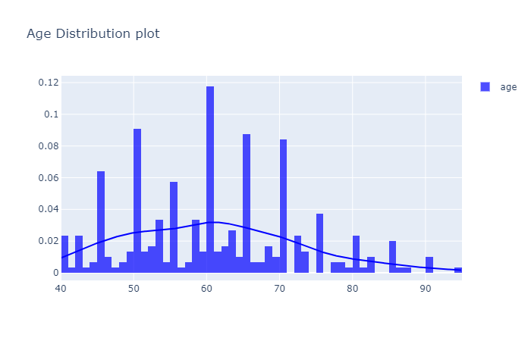
Actual Data: Age Distribution
45, 50, 60, 65, 70 years old are high risk ages

Slide 6
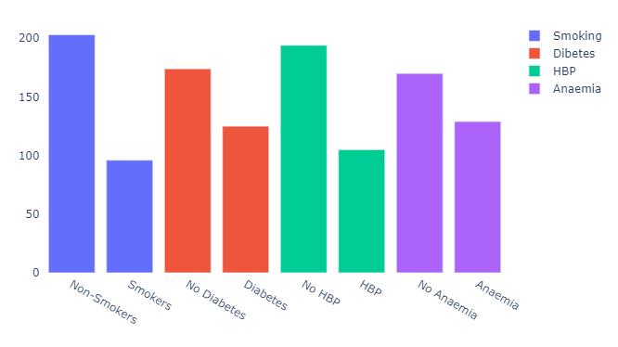
Actual Data: Other Conditions Vs Heart Failure
Non-smokers
Non-HBP
Non-Diabetes
Non-Anaemia
There is no relationship between Heart Failure and these conditions

Slide 7
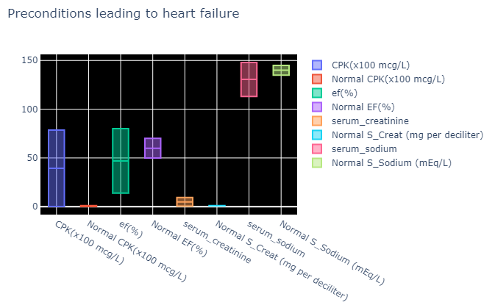
Normal Vs Abnormal range of health conditions
Normal range

Slide 8

Actual Data: Feature Selection
Age
Ejection Fraction
Serum Creatinine
Time
Serum Sodium

Slide 9
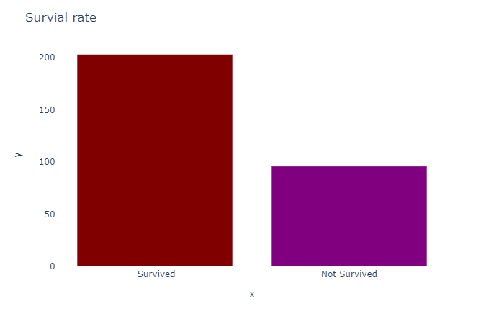
The Target Distribution
203
About 2/3 will Survive
96

Slide 10
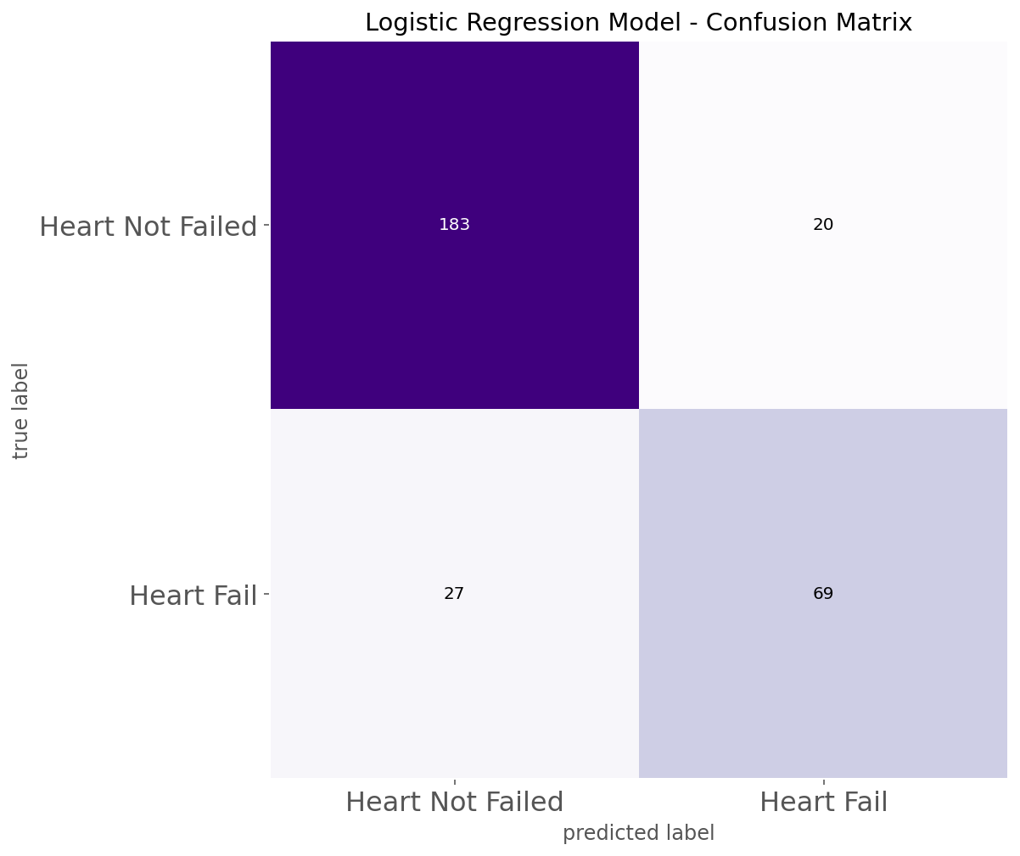
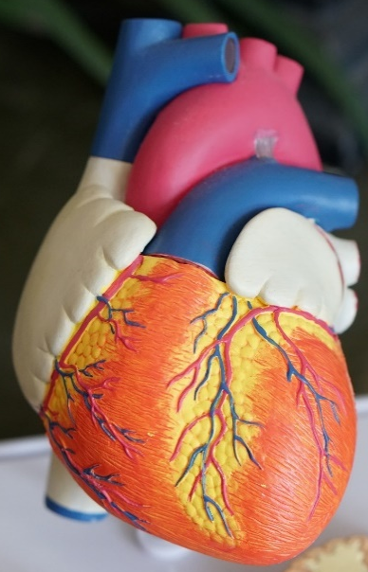
Actual Data
Confusion Matrix on Actual Data
203
96

Slide 11
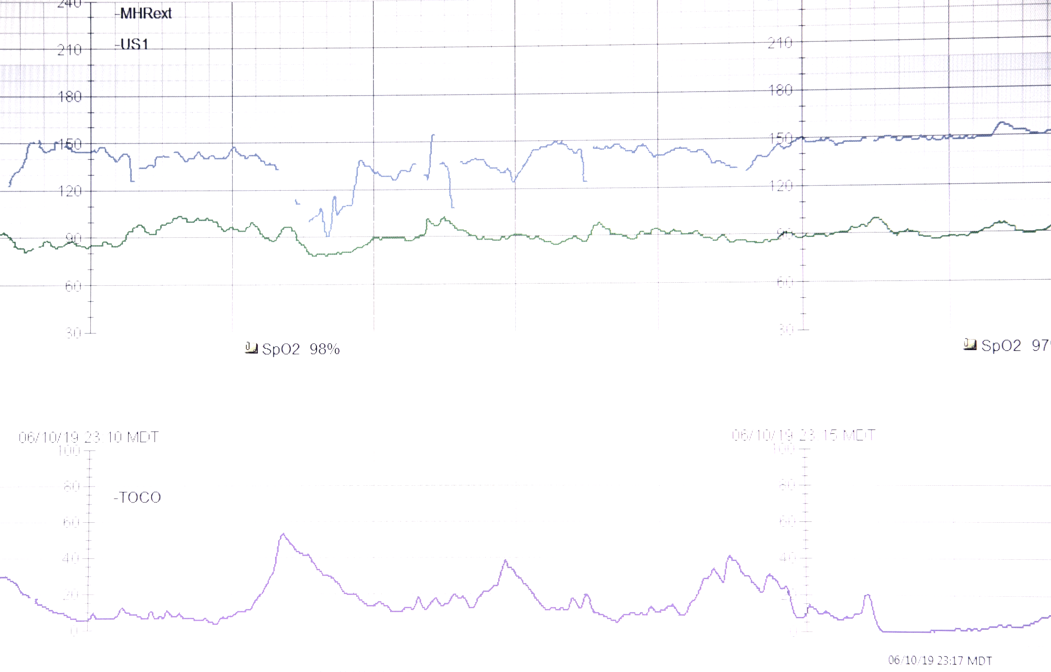
Supervised Learning Techniques
Logistic Regression
Support Vector Machines
K-Nearest Neighbour
Random Forest Classifier

Slide 12
Logistic Regression
Best Precision Score: 78.16%
Best Recall Score: 70.83%
Best F1 Score: 74.32%
184
19
28
68

Slide 13
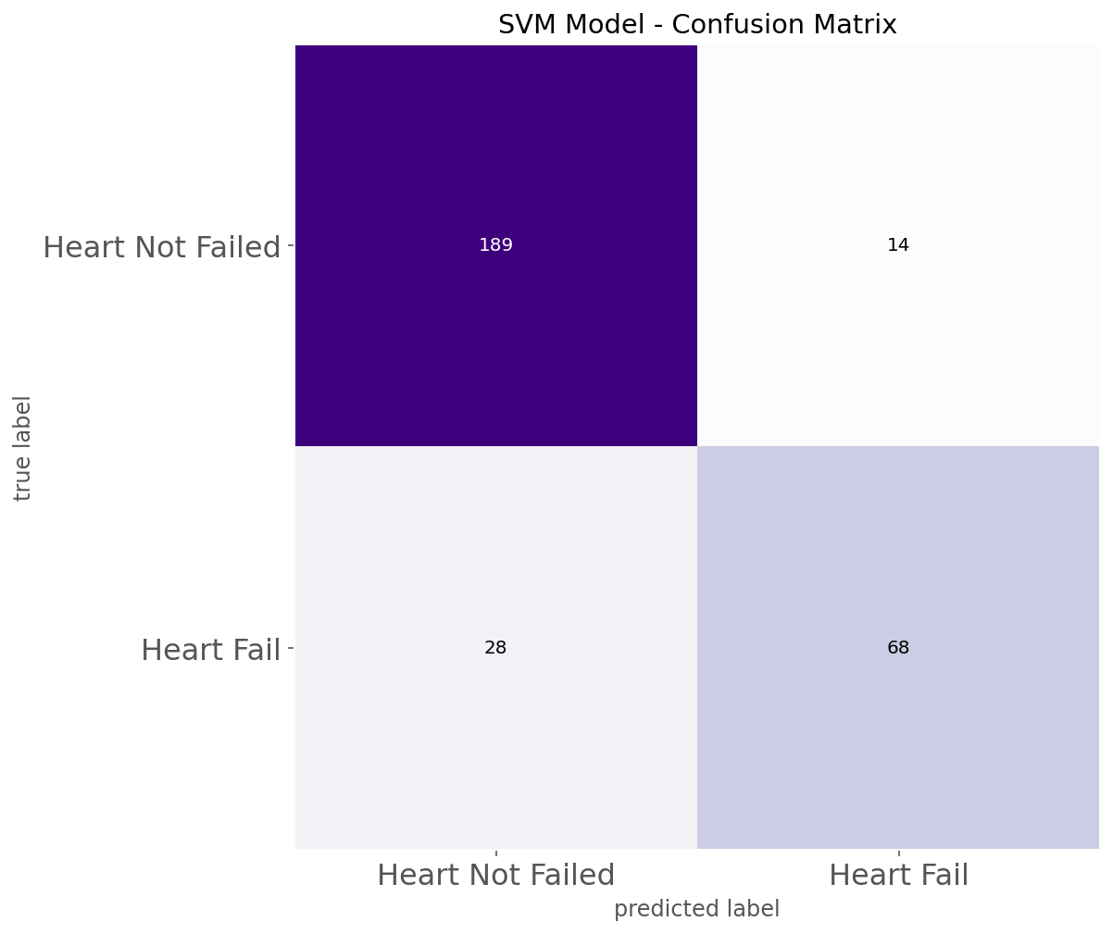
Support Vector Machines
Best Precision Score: 82.93%
Best Recall Score: 70.83%
Best F1 Score: 76.40%
189
14
28
68

Slide 14
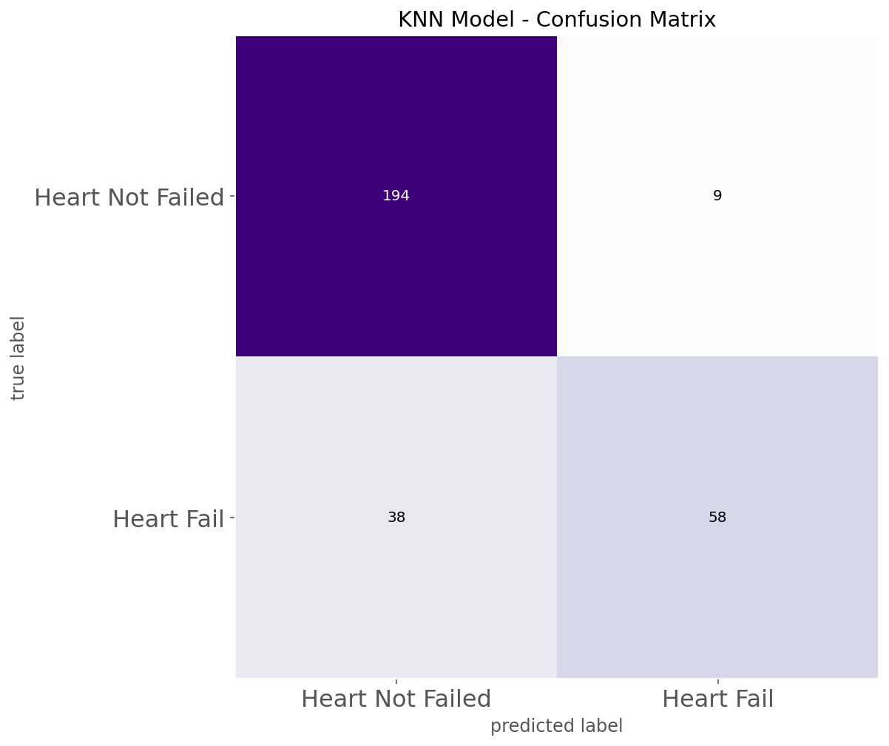
K-Nearest Neighbour
Best Precision Score: 86.57%
Best Recall Score: 60.42%
Best F1 Score:
71.17%
194
9
38
58

Slide 15
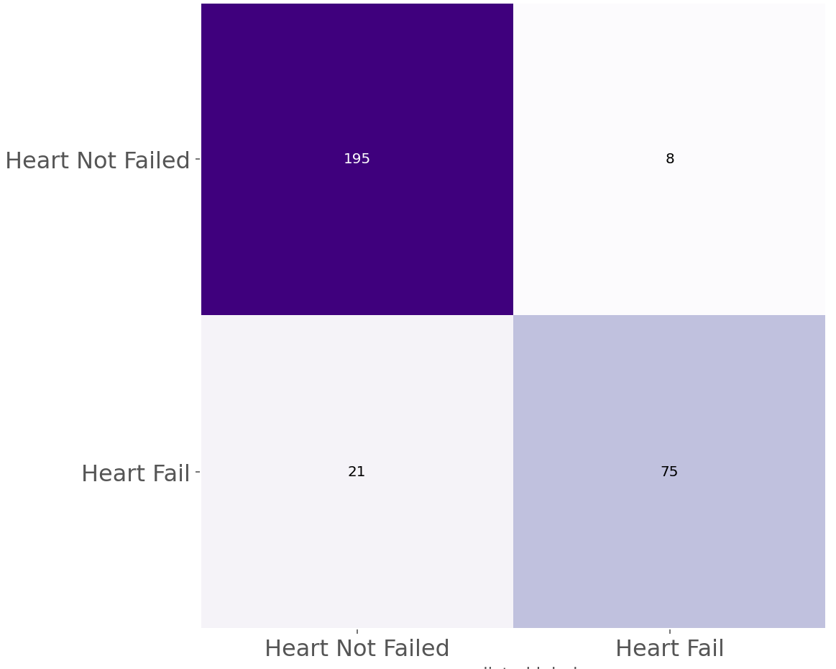
Random Forest Classifier
Best Precision Score 88.89%
Best Recall Score 83.33%
Best F1 Score
86.02%
RFC Model – Confusion Matrix
195
8
21
75

Slide 16

XGBoost
Best Precision Score: 86.05%
Best Recall Score: 77.08%
Best F1 Score:
81.32%
191
12
22
74

Slide 17
XGBoost (Tuned)
Best Precision Score 89.53%
Best Recall Score 80.21%
Best F1 Score:
84.62%
194
9
19
77

Slide 18
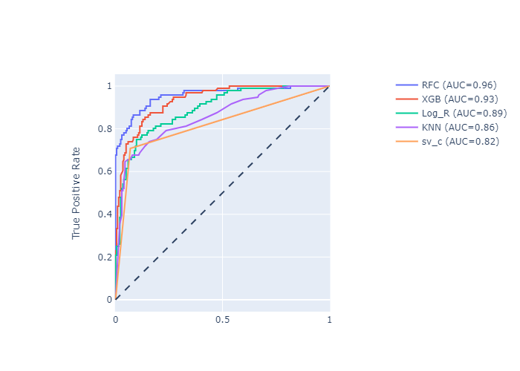
ROC AUC Curve Comparison
RF has the highest ROC_AUC score.

Slide 19
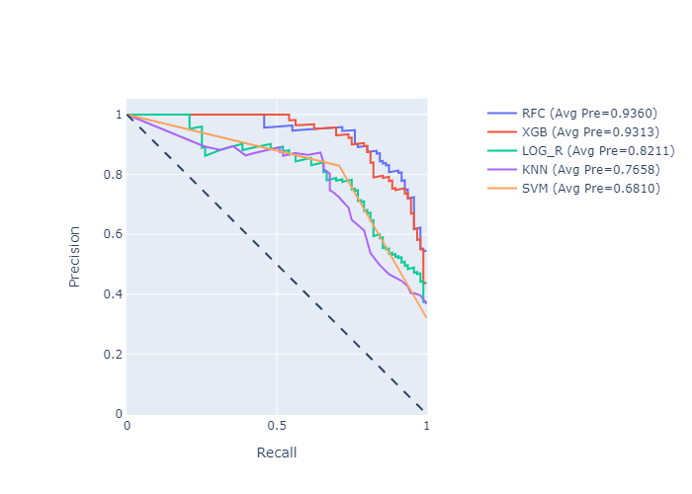
Precision and Recall Curve Comparison

Slide 20
Final Comparison
 | Precision | Recall | F1 | True-Pos (203) | True-Neg (96) | False
XGBoost (Tuned) | 89.53% | 80.21% | 84.62% | 194 | 77 | 28
RFC | 88.89% | 83.33% | 86.02% | 195 | 75 | 29
KNN | 86.57% | 60.42% | 71.17% | 194 | 58 | 47
Logistic Regression | 78.16% | 70.83%* | 74.32% | 184 | 68 | 47
SVM | 82.93% | 70.83%* | 76.40% | 189 | 68 | 42
* Double Checked. Found Good.
XGBoost when tuned provides the highest Precision and Recall.

Slide 21
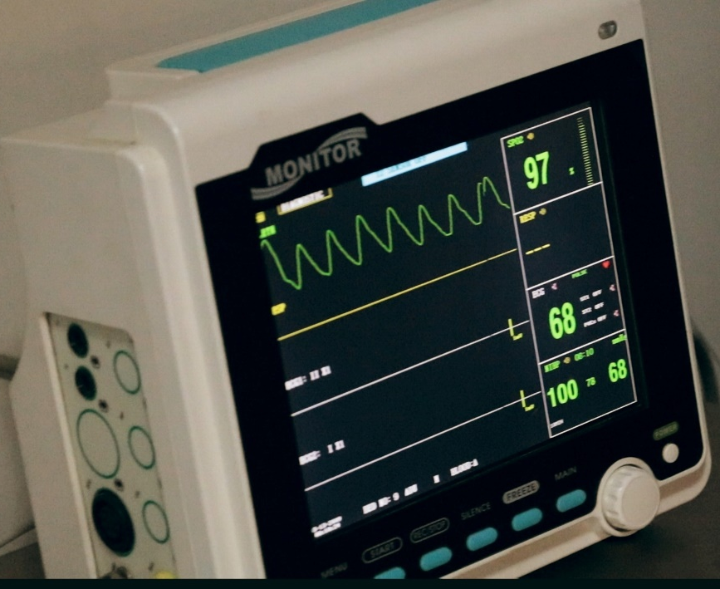
Improvements:
Include data directly affecting the heart such as Stress levels, Food Intake, Amount of Exercise per week and Cholesterol levels.
Explore using other models such as Ensemble and Naïve Based Models
Explore putting an app on flask for people to conduct a basic assessment of their heart condition.

Slide 22

Any Questions?
Thank you for your attention.
Follow me on linkedin:
https://www.linkedin.com/in/andrew-tan-41878671
https://github.com/guitarfly78

Slide 23
Appendix

Slide 24
Fun Facts of the Heart
Your heart will beat about 115,000 times each day.
Your heart pumps about 2,000 gallons of blood every day.
The heart can continue beating even when it’s disconnected from the body.
It’s possible to have a broken heart.
Laughing is good for your heart.

Slide 25

Header Details:
Continuous Data
Age : Patient's Age
creatinine_phosphokinase (CPK):
CPK is present when heart muscle is damaged
ejection_fraction (EF) :
EF is a measurement(%) of how much blood the left ventricle pumps out with each contraction
platelets : tiny blood cells that help your body form clots to stop bleeding
serum_creatinine : the level of creatinine in your blood (controlled by the kidney)
serum_sodium : how much sodium is in your blood (controlled by the kidney)

Slide 26
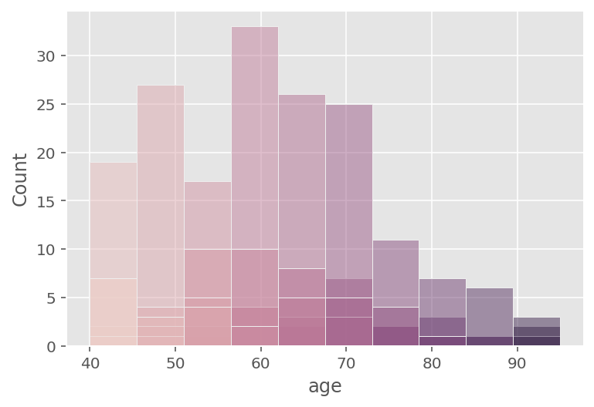
Actual Data: Age Vs Count
Highest around 60 years old

Slide 27
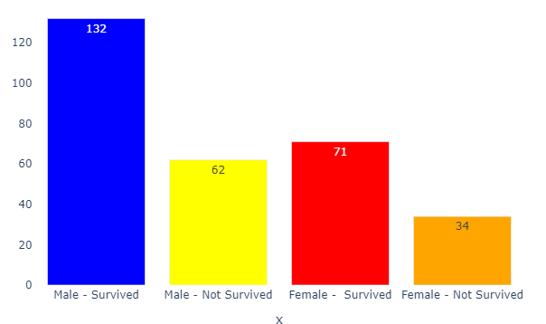
Actual Data: Survivability
about 65%-70%
Heart Failure patients will Survive

Slide 28
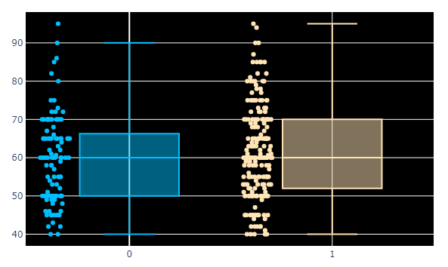
Actual Data: Female vs Male
High Risk Category¶
Female: 50 - 62 years old
Male: 52 - 70 years

